Slide 1
Telehealth Deserts: The Hidden Intersection of Healthcare Access & Connectivity
Daniel S. | Haoyuan C. | Tim B. | Marina P. | Ce. Z

Slide 2
COLUMBIA APPLIED ANALYTICS | GROUP 9 | APRIL 2026
THE DIGITAL DIVIDE
Technology has
transformed access
to healthcare.
3,800%
growth in telehealth
2019 to 2020
22.3%
Telehealth visits grew 3,800% from 2019 to 2020.
Virtual care is now a primary channel for millions.
of rural Americans
still lack broadband
~3.5M
But the expansion of digital health has not been equal.
Geography, income, and infrastructure still decide who benefits.
Americans living in
both gaps simultaneously
Daniel Haoyuan Tim Marina Ce

Slide 3



01 THE PROBLEM
Telehealth promises access.
Geography decides who gets it.
22.3%
244
$42.5B
of rural Americans
lack fixed broadband
MUA counties also
have <40% broadband (at 25mbps)
BEAD funding at risk
of missing the gap
USDA / FCC Form 477
HRSA + FCC, 2024
NTIA BEAD Allocation
Limited analysis currently joins these two datasets. BEAD allocations are being finalized now.

Slide 4
02 METHODOLOGY
Two public datasets.
One targeted shortlist: a success story.
DATA SOURCES
01
HRSA (Health Resources & Services Administration) Medically Underserved Area (MUA) Layer
Active Medically Underserved Area/Population designations at county level, joined via 5-digit FIPS (county ID) codes.
HRSA MUA/P Designations
FCC Form 477 (2014-2024)
02
Federal Communications Commission (FCC) Form 477
U.S. Census 2020
December 2024 broadband access data. Counties where <40% of households meet the 25 Mbps standard for internet is the BEAD unserved threshold.
ACS 5-Year 2023
03
Intersection = Telehealth Deserts for Broadband Prioritization
NTIA BEAD Allocation Tables
207 counties flagged with active MUA AND confirmed broadband gap. Built entirely on free public data.
CDC PLACES 2024
All sources: publicly available, free.

Slide 5
03 KEY FINDINGS
207 counties.
No federal shortlist existed until now.
207
75
60%+
~3.5M
Telehealth desert
counties identified
Concentrated in
5 Deep South states
Households without
25 Mbps coverage
Americans living in
telehealth deserts
TOP STATES BY TELEHEALTH DESERT COUNTIES
Mississippi
18
Louisiana
17
Georgia
16
Alabama
14
Illinois
14
Source: HRSA MUA Designations + FCC Form 477, Dec 2024

Slide 6
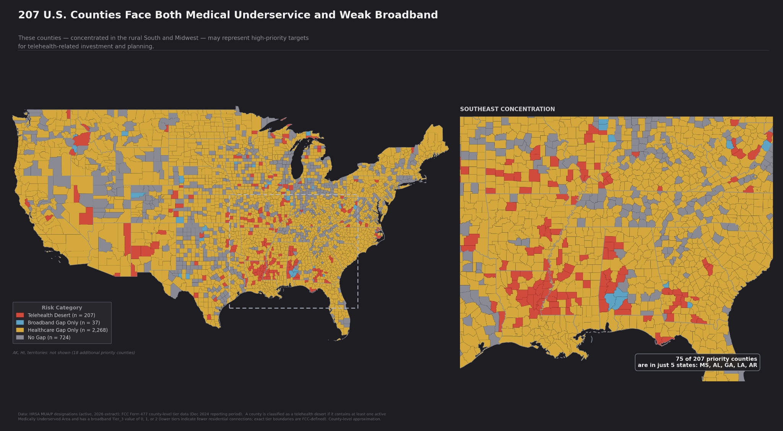

Slide 7
The BEAD window is open right now.
Three actions. One window. No second chance at this scale.
01
02
03
Put 207-county’s name on the list before states finalize their plans.
We are making health-access decisions on six-month-old data. That needs to be changed.
Two or three conversations could change what states are required to consider.
Authorize HRSA to submit the 207-county telehealth desert list to NTIA — this quarter.
Approve a joint data-sharing agreement with the FCC — so HRSA's health-access case is built on live data, not lagged estimates.
Direct HRSA communications to brief two or three Senate health committee staffers before the comment period closes — and ask them to put health-access language in writing.
●
TELEHEALTH DESERTS

Slide 8



04 VALUE PROPOSITION
Maximum impact. Minimum new spend.
The foundation for future opportunity.
Free Public Data &
Minimal Compute
Multi-Agency
Leverage
Mission Alignment &
Future Directions
Every dataset is publicly available at zero cost. Compute requirements are lightweight — existing HRSA infrastructure is sufficient. No new data purchases or contracts required.
Three federal agencies already own the data. HRSA coordinates, FCC contributes broadband layers, NTIA brings BEAD logic. Staff and existing resources are the primary investment.
Positions HRSA as a proactive, data-forward agency. The methodology extends naturally to indigenous lands, redlining histories, food deserts, and mental health shortages.
$0 data low compute
FCC Census NTIA
HRSA 2024 Strategic Plan

Slide 9

05 THE ASK
Small investment.
Big impact.
What we need to continue
VALUE CREATED already
3-4 person Data Analysis team
variable
207 counties
prioritized with defensible, reproducible data
Access to HRSA internal MUA database
$0
Replicable tool
scales annually as BEAD and FCC data refresh
Interagency data-sharing (FCC, NTIA)
$0
HRSA as convener
to lead the federal health analytics conversation
Lightweight public dashboard hosting
< $10K/yr
Lives improved
measurable, target outcome
For the $42.5B BEAD allocation, our defensible shortlist of 207 counties provided a meaningful starting point for states

Slide 10




Where next and what your approval brings.
01
02
03
Use data to create human-centered
resources
Initiate interagency work
Create & maintain a
central repository
Authorize investment to develop health-centric resources
Partner with FCC and CDC to integrate data, ensuring human lives always remain center
Release findings annually, informing the public and guiding other agencies on where gaps remain.
FUTURE DIRECTIONS
Indigenous &
Tribal Lands
Redlining &
Racial Equity
Food Deserts &
Social Needs
Mental Health
Shortage Areas
Sovereign data gaps
Historic exclusion layers
SDOH intersection
HPSA expansion
Daniel Haoyuan Tim Marina Ce Columbia Applied Analytics 2026

Slide 11
~3.5 million Americans.
HRSA's mission:
to improve health
equity by expanding
access to quality
health care.
That is how many people a quick analysis already found
living in telehealth deserts - with existing public data.
With minimal investment, HRSA has the opportunity
to become the collaborative federal agency that
ensures no American is left behind in the digital age.
This analysis is that
mission in action.
The data exists. The methodology works.
The window is now.
Columbia Applied Analytics | Group 9
Daniel Haoyuan Tim Marina Ce April 2026

Slide 12
References
Centers for Disease Control and Prevention. PLACES: Local Data for Better Health, 2024 Release. Atlanta, GA: CDC Division of Population Health, 2024. https://www.cdc.gov/places.
Federal Communications Commission. FCC Form 477 County-Level Fixed Broadband Deployment Data, 2014-2024. Washington, DC: Federal Communications Commission, 2024. https://www.fcc.gov/general/broadband-deployment-data-fcc-form-477.
National Telecommunications and Information Administration. Broadband Equity, Access, and Deployment (BEAD) Program State Allocation Tables. Washington, DC: U.S. Department of Commerce, 2024. https://www.ntia.gov/programs-and-initiatives/broadband/bead-program.
U.S. Census Bureau. 2020 Census Redistricting Data (Public Law 94-171) Summary File. Washington, DC: U.S. Census Bureau, 2021. https://www.census.gov/programs-surveys/decennial-census/about/rdo/summary-files.html.
U.S. Census Bureau. American Community Survey 5-Year Estimates, 2019-2023. Washington, DC: U.S. Census Bureau, 2023. https://www.census.gov/programs-surveys/acs/data.html.
U.S. Health Resources and Services Administration. Medically Underserved Areas and Populations (MUA/P) Designations. Rockville, MD: HRSA Bureau of Health Workforce, 2024. https://data.hrsa.gov/data/download.
Columbia University Applied Analytics | Group 9 | April 2026

